Slide 1

CPQ – Asia Product Variation Design and Mock Up Dec ‘19
Colt confidential

Slide 2

Document Release and Change Log Details
CPQ Asia
Version Number | 0.9
Date | 25th , Nov, 2019
Change log 0.8 | Product Variation changes- Ethernet Line Product Variation – Ethernet Hub Product Variation – Ethernet Spoke Product Variation – IP Access Product Variation – Wave Product Variation – Professional Services Container Journey – Open Items
Change log 0.9 | Updated the slides based upon the product management feedback – ‘Sonet’ Updated the slide to change the rule based upon the legal country for ‘Type of AS’ and ‘PI Resource Management’’

Slide 3
Productised Products – Ethernet Products (Asia Variation)
Generic
Ethernet Line , Ethernet H&S
Hong Kong Supplier Surcharge
Shall be visible if applicable.
Internal Cabling
Shall not be available if Access Type other than Colt Fiber.
Fast Track
Not available in Asia
Building Management Owner Charge
Shall be possible to be manually entered if applicable.
Relay Fiber
New Field required without any rule set as depending on value different workflows will be triggered in SPARK Asia. Interface logic needed to pass ULL Supplier first as only when specific Business rule met in SPARK Interface will allow to pass the value.
Link Aggregation
Demarcation Device
Diversity
Class of Service
Above features are not Available currently in Asia as Service Delivery processes for these features in Asia are yet to be defined. Approach to achieve the same to be discussed and agreed
Dual Customer Power Source
Feature to be disabled in EU to align with Asia.

Slide 4
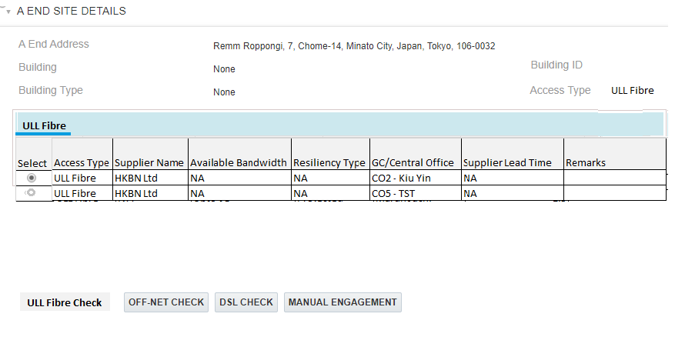
CPQ Asia : Ethernet Line – Supplier Surcharge
In Hong Kong , while doing the ULL check if the Building Type = ‘Retail Building (Long-Lining)’ then there is surcharge which needs to be added to the based price.
System should a message to user saying ‘A Surcharge has been added to the base price as the site is 10 KM from Central office’
The LL surcharge prices has to be implemented in the system , which is present in PAPIC. LL Surcharge for Hong Kong has to be uploaded in a CPQ data table.
The LL surcharge is not required to be shown on ‘Quote Line Item Grid’, ‘Quote Download Template’ , ‘Proposal’ and ‘Pricing Grid’
This is required across all product (except PS) when the country is Hong Kong
742-748 Cheung Sha Wan Road, Cheung Sha Wan, Hong Kong
4

Slide 5
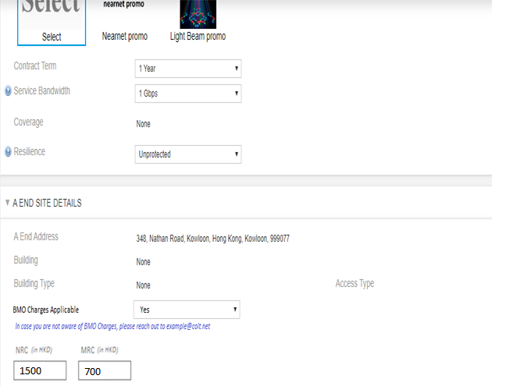
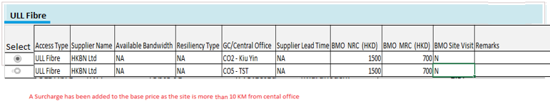
CPQ Asia : CPQ Asia : Ethernet Line-BMO
‘BMO Charge Applicable’ will shown on the Site details page when the ‘Site Country = ‘Hong Kong’’ . This field will be a mandatory field.
‘BMO Charge Applicable’ should be a LOV with a default value as ‘Please Select’ . User can click in the drop down to select ‘Yes’ / ‘No’
When the Site country is other then ‘Hong Kong’ then this field will be hidden.
There will be a guidance message appearing on the screen for those user who are not aware BMO charges
Sales can refer the ULL connectivity check table to view the BMO related for guidance. These field are strictly for guidance purpose.
If user selects the BMO charges applicable then:
Sales user will be shown two fields to capture NRC and MRC
Sales are expected to manually enter the charges in HKG

Slide 6
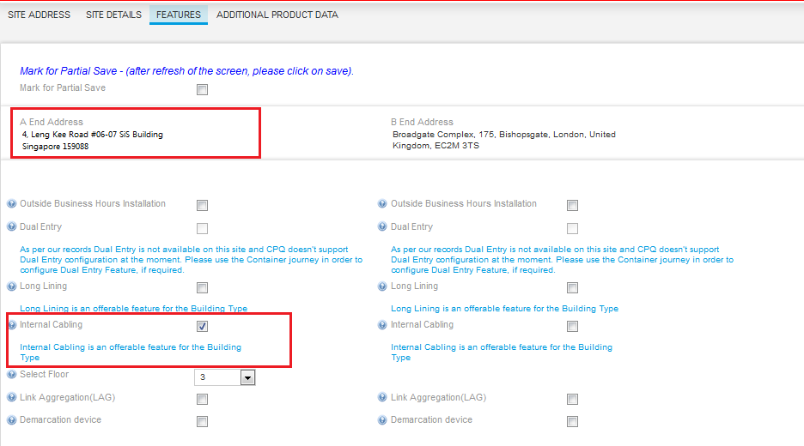
CPQ Asia : Ethernet Line-Internal cabling
Additionally to existing ruleset Internal Cabling is a globally orderable feature at site level when Access type is Colt Fibre. It will be not applicable for any other access type.
Charge for Internal cabling for Asian sites will always be zero when Site Country is = ‘Japan’, Singapore’,’Hong Kong’ , ‘South Korea’ .

Slide 7
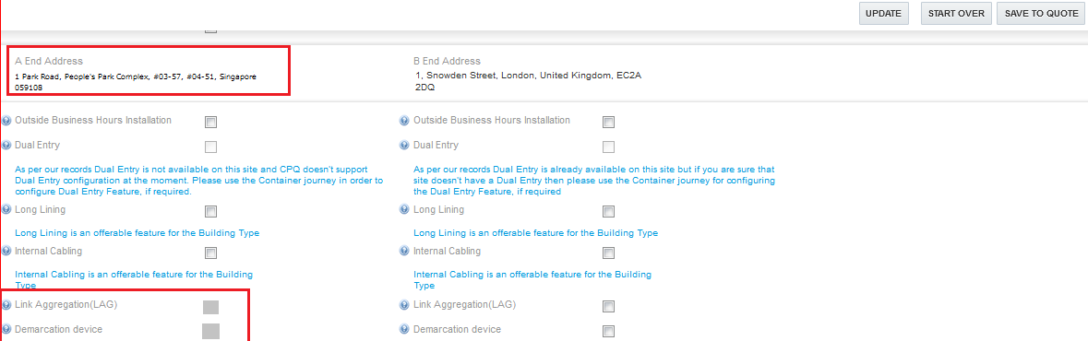
CPQ Asia : Ethernet Line-Link Aggregation
Link Aggregation is a Site level feature
It will be disabled for selection if site country is in Asia (JP,HK,SK,SG)

Slide 8
CPQ Asia : Ethernet Line-Demarcation Device
Demarcation Device is a Site level feature.
It will be disabled for selection if site country is in Asia( JP,HK,SG,SK)

Slide 9
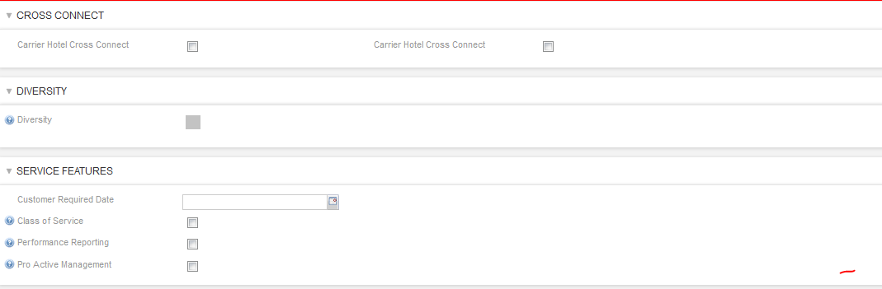
CPQ Asia : Ethernet Line-Diversity
Diversity is a service level feature
It will be disabled for selection when one site is in Asia (JP,HK,SG,SK)

Slide 10
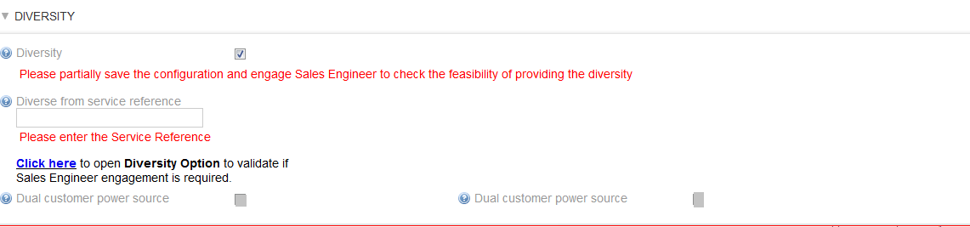
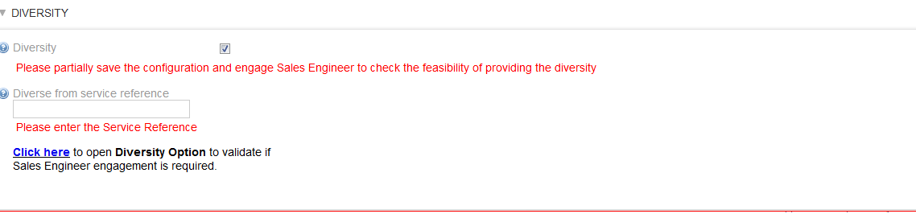
CPQ Asia : Ethernet Line-Dual customer Power Source
Dual Customer Power Source to be removed from CPQ for selection in Ethernet Line journey for both EU and Asia
CPQ should send the ‘Dual Customer Power Source’ as ‘No’ to Siebel in Manage Order
As –is UI
Proposed UI – Dual Customer Power Source Removed

Slide 11
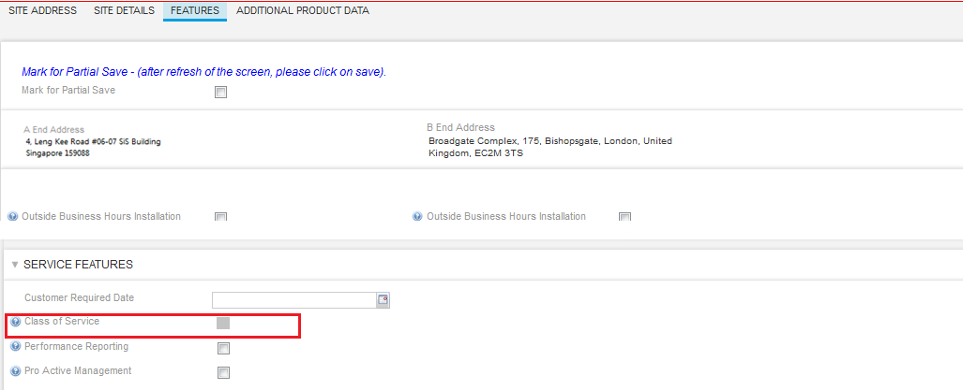
CPQ Asia : Ethernet Line-Class Of Service
Class of service is a service level feature available
When one of the Site Country is = ‘Japan’, Singapore’,’HongKong’ , ‘South Korea’ then this feature has to be disabled

Slide 12
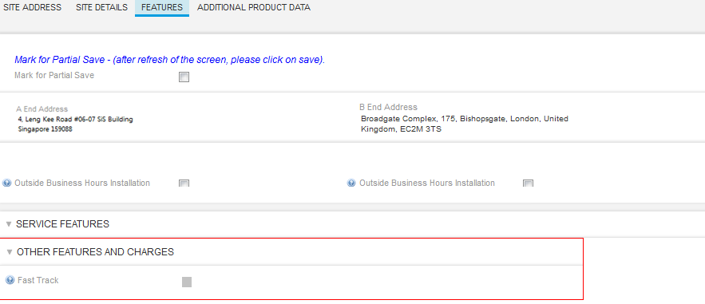
CPQ Asia : Ethernet Line-Fast Track
Fast Track is a service level feature
When one of the Site Country is = ‘Japan’, Singapore’,’HongKong’ , ‘South Korea’ then this feature has to be disabled

Slide 13
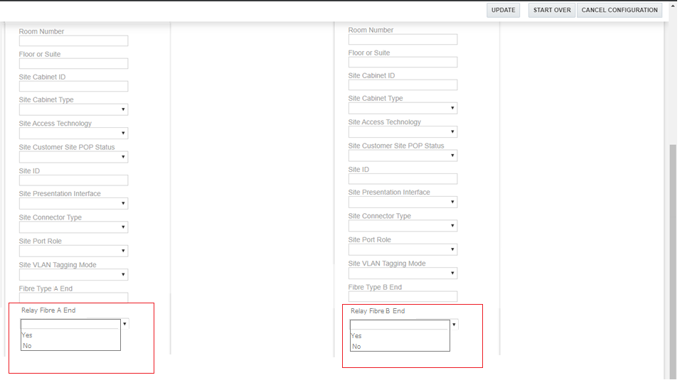
CPQ Asia : Ethernet Line-Relay Fibre
CST will be allowed to optionally select Relay Fibre options (Yes, No, Blank) under additional product data during technical review journey
Fibre Relay field will only be enabled in CPQ when ULL Suppliers for Japan are NTTEAST(JP) or NTTWEST(JP).
Relay Fibre can be selected at site level.

Slide 14
Productised Products – Ethernet Products (Asia Variation)
Generic
Ethernet Hub
Hong Kong Supplier Surcharge
Shall be visible if applicable.
Internal Cabling
Shall not be available if Access Type other than Colt Fiber.
Fast Track
Not available in Asia
Building Management Owner Charge
Shall be possible to be manually entered if applicable.
Relay Fiber
New Field required without any rule set as depending on value different workflows will be triggered in SPARK Asia. Interface logic needed to pass ULL Supplier first as only when specific Business rule met in SPARK Interface will allow to pass the value.
Link Aggregation
Demarcation Device
Diversity
Class of Service
Above not applicable in Asia. Pricing and process not available yet and to be investigated. Target alignment date sometime 2020.
Dual Customer Power Source
Feature to be disabled in EU to align with Asia.

Slide 15
CPQ Asia : Ethernet Hub- Supplier Surcharge for HK
In Hong Kong , while doing the ULL check if the Building Type = ‘Retail Building (Long-Lining)’ then there is surcharge which needs to be added to the based price.
System should a message to user saying ‘A Surcharge has been added to the base price as the site is 10 KM from Central office’
The LL surcharge prices has to be implemented in the system , which is present in PAPIC. LL Surcharge for Hong Kong has to be uploaded in a CPQ data table.
The LL surcharge is not required to be shown on ‘Quote Line Item Grid’, ‘Quote Download Template’ , ‘Proposal’ and ‘Pricing Grid’
This is required across all product (except PS) when the country is Hong Kong
742-748 Cheung Sha Wan Road, Cheung Sha Wan, Hong Kong
15

Slide 16
CPQ Asia : CPQ Asia : Ethernet Hub-BMO
‘BMO Charge Applicable’ will shown on the Site details page when the ‘Site Country = ‘Hong Kong’’. BMO charge Applicable field would be mandatory for Hong Kong (on Site detail page)
‘BMO Charge Applicable’ should be a LOV with a default value as ‘Please Select’ . User can click in the drop down to select ‘Yes’ / ‘No’
When the Site country is other then ‘Hong Kong’ then this field will be hidden.
There will be a guidance message appearing on the screen for those user who are not aware BMO charges
Sales can refer the ULL connectivity check table to view the BMO related for guidance. These field are strictly for guidance purpose.
If user selects the BMO charges applicable then:
Sales user will be shown two fields to capture NRC and MRC
Sales are expected to manually enter the charges in HKG

Slide 17
CPQ Asia : Ethernet Hub-Internal cabling
Internal Cabling is a globally orderable feature at site level when Access type is Colt Fibre. It will be not applicable for any other access type.
Charge for Internal cabling for Asian sites will always be zero when Site Country is = ‘Japan’, Singapore’,’Hong Kong’ , ‘South Korea’ .

Slide 18
CPQ Asia : Ethernet Hub-Link Aggregation
Link Aggregation is a Site level feature
It will be disabled for selection if site country is in Asia (JP,HK,SK,SG)

Slide 19
CPQ Asia : Ethernet Hub-Demarcation Device
Demarcation Device is a Site level feature.
It will be disabled for selection if site country is in Asia( JP,HK,SG,SK)

Slide 20
CPQ Asia : Ethernet Hub-Fast Track
Fast Track is a service level feature
When one of the Site Country is = ‘Japan’, Singapore’,’Hong Kong’ , ‘South Korea’ then this feature has to be disabled

Slide 21
CPQ Asia : Ethernet Hub-Relay Fibre
CST will be allowed to optionally select Relay Fibre options (Yes, No, Blank) under additional product data during technical review journey
Fibre Relay field will only be enabled in CPQ when ULL Suppliers for Japan are NTTEAST(JP) or NTTWEST(JP). For all other scenarios it will be disabled.
Relay Fibre can be selected at site level.

Slide 22
Productised Products – Ethernet Products (Asia Variation)
Generic
Ethernet Spoke
Hong Kong Supplier Surcharge
Shall be visible if applicable.
Internal Cabling
Shall not be available if Access Type other than Colt Fiber.
Fast Track
Not available in Asia
Building Management Owner Charge
Shall be possible to be manually entered if applicable.
Relay Fiber
New Field required without any rule set as depending on value different workflows will be triggered in SPARK Asia. Interface logic needed to pass ULL Supplier first as only when specific Business rule met in SPARK Interface will allow to pass the value.
Link Aggregation
Demarcation Device
Diversity
Class of Service
Above not applicable in Asia. Pricing and process not available yet and to be investigated. Target alignment date sometime 2020.
Dual Customer Power Source
Feature to be disabled in EU to align with Asia.

Slide 23
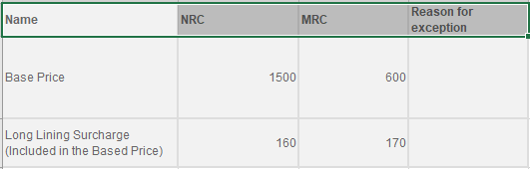
CPQ Asia : Ethernet Spoke-Long Line Surcharge
In Hong Kong , while doing the ULL check if the Building Type = ‘Retail Building (Long-Lining)’ then there is surcharge which needs to be added to the based price.
System should a message to user saying ‘A Surcharge has been added to the base price as the site is 10 KM from Central office’
The LL surcharge prices has to be implemented in the system , which is present in PAPIC. LL Surcharge for Hong Kong has to be uploaded in a CPQ data table.
The LL surcharge is not required to be shown on ‘Quote Line Item Grid’, ‘Quote Download Template’ , ‘Proposal’ and ‘Pricing Grid’
This is required across all product (except PS) when the country is Hong Kong
742-748 Cheung Sha Wan Road, Cheung Sha Wan, Hong Kong
Price Grid
23

Slide 24
CPQ Asia : CPQ Asia : Ethernet Spoke-BMO
‘BMO Charge Applicable’ will shown on the Site details page when the ‘Site Country = ‘Hong Kong’’.It is mandatory field for Hong Kong
‘BMO Charge Applicable’ should be a LOV with a default value as ‘Please Select’ . User can click in the drop down to select ‘Yes’ / ‘No’
When the Site country is other then ‘Hong Kong’ then this field will be hidden.
There will be a guidance message appearing on the screen for those user who are not aware BMO charges
Sales can refer the ULL connectivity check table to view the BMO related for guidance. These field are strictly for guidance purpose.
If user selects the BMO charges applicable then:
Sales user will be shown two fields to capture NRC and MRC
Sales are expected to manually enter the charges in HKG

Slide 25
CPQ Asia : Ethernet Spoke-Internal cabling
Internal Cabling is a globally orderable feature at site level when Access type is Colt Fibre. It will be not applicable for any other access type.
Charge for Internal cabling for Asian sites will always be zero when Site Country is = ‘Japan’, Singapore’,’HongKong’ , ‘South Korea’ .

Slide 26
CPQ Asia : Ethernet Spoke-Link Aggregation
Link Aggregation is a Site level feature
It will be disabled for selection if site country is in Asia (JP,HK,SK,SG)

Slide 27
CPQ Asia : Ethernet Spoke-Demarcation Device
Demarcation Device is a Site level feature.
It will be disabled for selection if site country is in Asia( JP,HK,SG,SK)

Slide 28
CPQ Asia : Ethernet Spoke-Diversity
Diversity is a service level feature
It will be disabled for selection when one site country is in Asia (JP,HK,SG,SK)

Slide 29
CPQ Asia : Ethernet Spoke-Class Of Service
Class of service is a service level feature available
It will be disabled for selection if one site is in Asia (JP,HK,SK,SG)

Slide 30
CPQ Asia : Ethernet Spoke-Dual customer Power Source
Dual Customer Power Source to be removed from CPQ for selection in Ethernet Hub journey for both EU and Asia
CPQ should send the ‘Dual Customer Power Source’ as ‘No’ to Siebel in Manage Order
As –is UI
Proposed UI – Dual Customer Power Source Removed

Slide 31
CPQ Asia : Ethernet Spoke-Fast Track
Fast Track is a service level feature
When one of the Site Country is = ‘Japan’, Singapore’,’HongKong’ , ‘South Korea’ , this feature has to be disabled

Slide 32
CPQ Asia : Ethernet Spoke-Relay Fibre
CST will be allowed to optionally select Relay Fibre options (Yes, No, Blank) under additional product data during technical review journey
Fibre Relay field will only be enabled in CPQ when ULL Suppliers for Japan are NTTEAST(JP) or NTTWEST(JP). For all other scenarios this field will be hidden
Relay Fibre can be selected at site level.

Slide 33
Productised Products – IP Access (Asia Variation)
Generic
IPAccess Specific - Agreed
Hong Kong Supplier Surcharge
Shall be visible if applicable.
Internal Cabling
Shall not be available if Access Type other than Colt Fiber.
Fast Track
Not available in Asia
Building Management Owner Charge
Shall be possible to be manually entered if applicable.
Relay Fiber
New Field required without any rule set as depending on value different workflows will be triggered in SPARK Asia. Interface logic needed to pass ULL Supplier first as only when specific Business rule met in SPARK Interface will allow to pass the value.
New BGP and
New PI IP Addresses
PI Resource Management ‘By Colt’ not supported
Above features are not Available currently in Asia as Service Delivery processes for these features in Asia are yet to be defined. Approach to achieve the same to be discussed and agreed
Performance Reporting
Gold Reporting not available in Asia.
Managed Virtual Firewall
Not available in Asia.

Slide 34
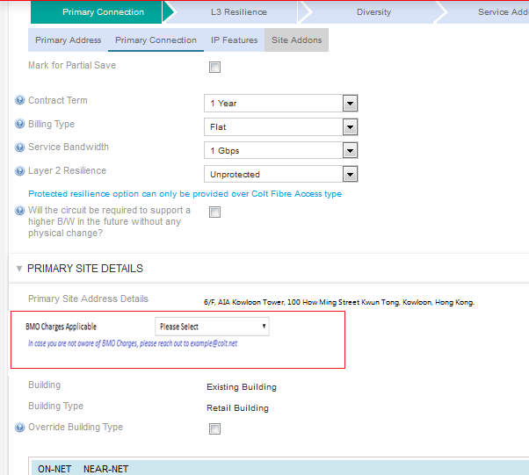
CPQ Asia : IP Access-Supplier Surcharge
In Hong Kong , while doing the ULL check if the Building Type = ‘Retail Building (Long-Lining)’ then there is surcharge which needs to be added to the based price.
System should a message to user saying ‘A Surcharge has been added to the base price as the site is 10 KM from Central office’
The LL surcharge prices has to be implemented in the system , which is present in PAPIC. LL Surcharge for Hong Kong has to be uploaded in a CPQ data table.
The LL surcharge is not required to be shown on ‘Quote Line Item Grid’, ‘Quote Download Template’ , ‘Proposal’ and ‘Pricing Grid’
This is required across all product (except PS) when the country is Hong Kong
34

Slide 35
CPQ Asia : IP Access- BMO
BMO charges will shown on ‘Primary Connection’ and ‘Secondary Connection’ page for IPAccess, if site country is Hong Kong.
This field will be a mandatory field.
‘BMO Charge Applicable’ should be a LOV with a default value as ‘Please Select’ . User can click in the drop down to select ‘Yes’ / ‘No’
When the Site country is other then ‘Hong Kong’ then this field will be hidden.
There will be a guidance message appearing on the screen for those user who are not aware BMO charges
Sales can refer the ULL connectivity check table to view the BMO related for guidance. These field are strictly for guidance purpose.
If user selects the BMO charges applicable then:
Sales user will be shown two fields to capture NRC and MRC
Sales are expected to manually enter the charges in HKG

Slide 36
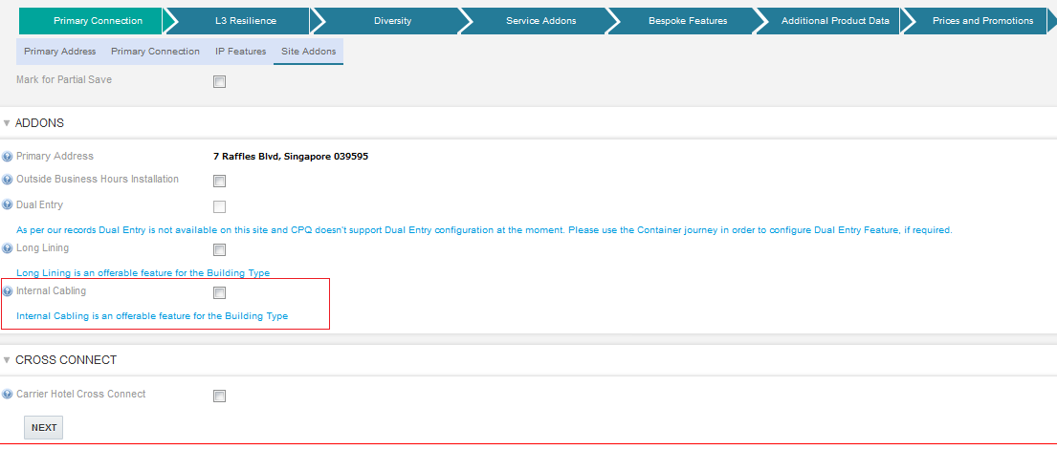
CPQ Asia : IP Access-Internal cabling
Internal Cabling is a globally orderable feature at site level when Access type is Colt Fibre. It will be not applicable for any other access type.
Charge for Internal cabling for Asian sites will always be zero when Site Country in ( JP,HK,SK,SG)

Slide 37
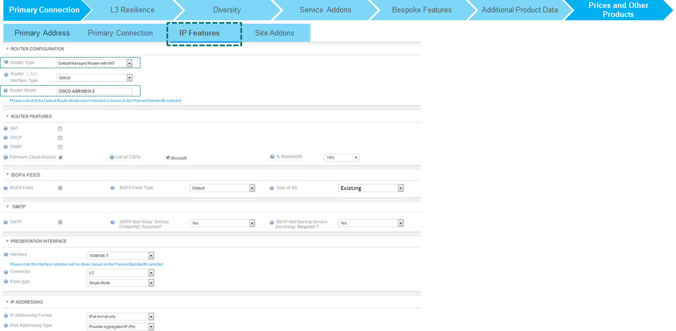
CPQ Asia: IPAccess : Type of AS
Type of AS field present on the IP Feature tab for IPAccess product. The drop down value ‘New’ is not applicable for Asia and should be removed if the Legal Country in (JP,HK,SK,SG)

Slide 38
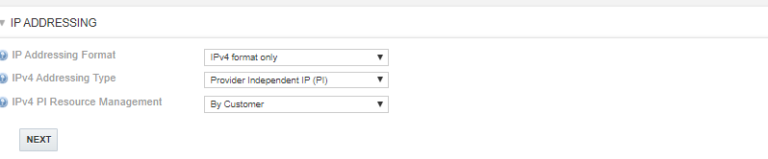
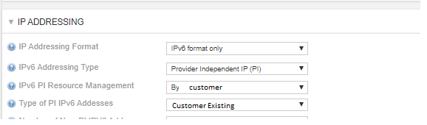
CPQ Asia: IPAccess : PI Resource Management
If the IPV4 Addressing Type = ‘Provider Independent IP(PI)’ then the IPV4 PI Resource Management will have only one option ‘By Customer’ . Option to select ‘By Colt’ has to be removed when the Legal country is in (JP,HK,SK,SG)
If the IPV6 Addressing Type = ‘Provider Independent IP(PI)’ then the IPV6 PI Resource Management will have only one option ‘By Customer’ . Option to select ‘By Colt’ has to be removed when the Legal country is in (JP,HK,SK,SG)
Type of Pi IPV6 Address can only have value as ‘Customer Existing’. Option to select ‘New’ has to be removed when the Legal country is in (JP,HK,SK,SG)

Slide 39
CPQ Asia: IPAccess : PI Resource Management
If the IPV4 Addressing Type = ‘Provider Independent IP(PI)’ then the IPV4 PI Resource Management will have only one option ‘By Customer’ . Option to select ‘By Colt’ has to be removed when the Legal country is in (JP,HK,SK,SG)
If the IPV6 Addressing Type = ‘Provider Independent IP(PI)’ then the IPV6 PI Resource Management will have only one option ‘By Customer’ . Option to select ‘By Colt’ has to be removed when the Legal country is in (JP,HK,SK,SG)
Type of Pi IPV6 Address can only have value as ‘Customer Existing’. Option to select ‘New’ has to be removed when the Legal country is in (JP,HK,SK,SG)

Slide 40
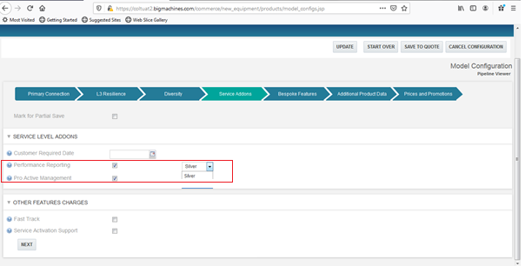
CPQ Asia : IP Access- Performance Reporting
Gold Reporting under performance reporting will not be available for Asian sites
CPQ will not show the “Gold” option in the drop-down when site is an Asian site (JP,SG,HK,SK)

Slide 41
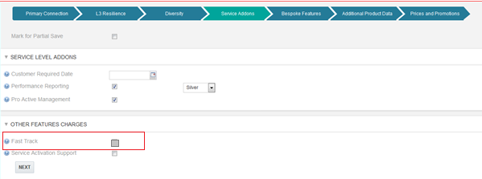
CPQ Asia : IP Access- Fast Track
Fast Track is a service level feature
If the Site Country in JP,HK,SK,SG, then this feature has to be disabled

Slide 42
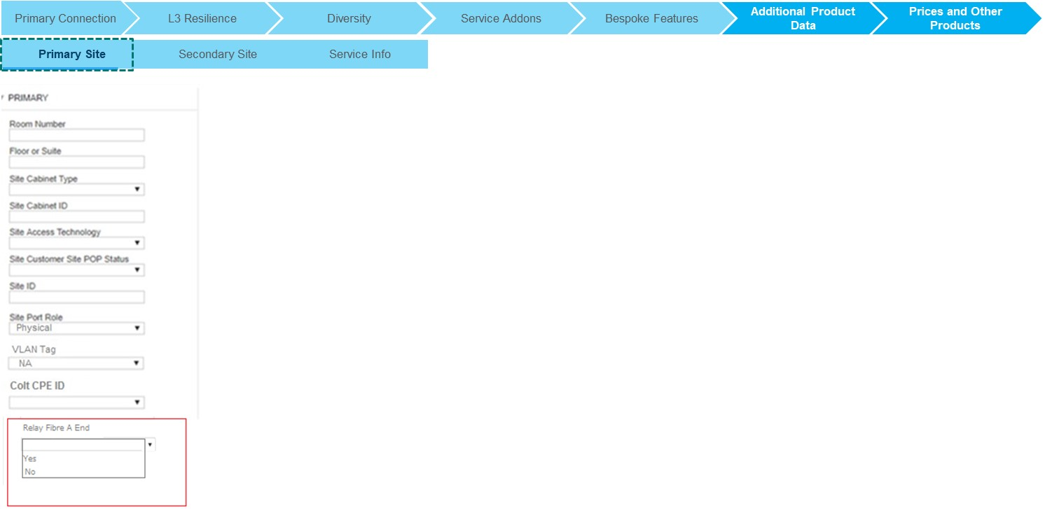
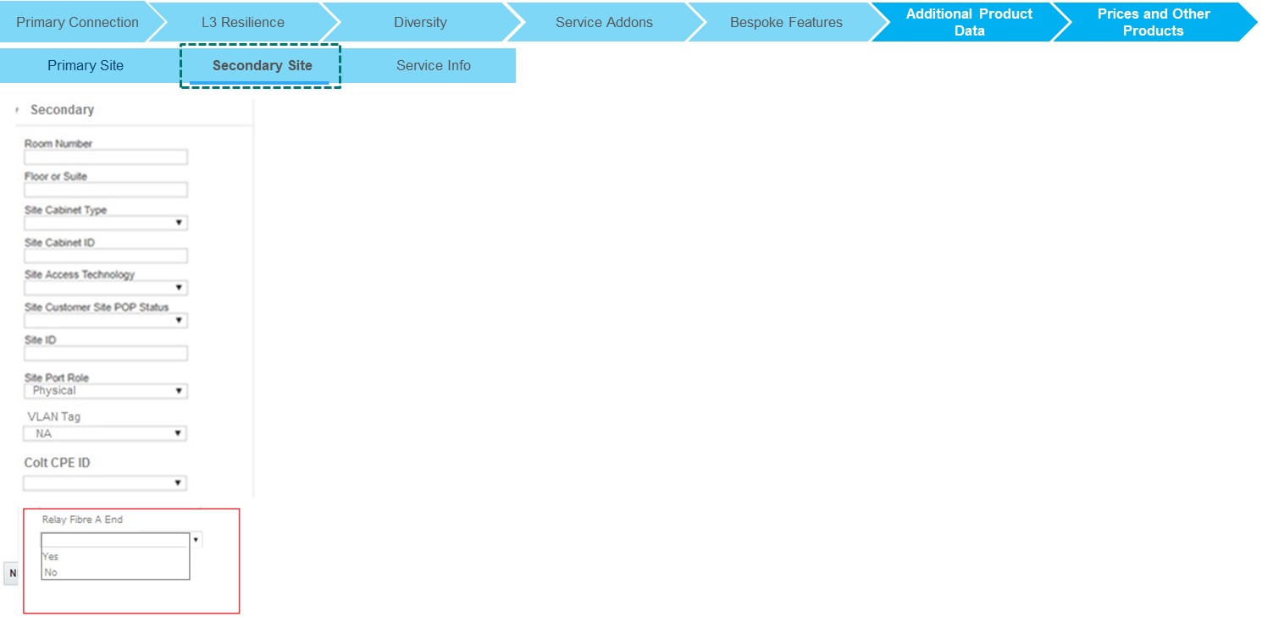
CPQ Asia : IP Access-Relay Fibre
CST will be allowed to optionally select Relay Fibre options (Yes, No, Blank) under additional product data during technical review journey
Fibre Relay field will only be enabled in CPQ when ULL Suppliers for Japan are NTTEAST(JP) or NTTWEST(JP). For all other cases this field should be hidden.
Relay Fibre can be selected at site level.

Slide 43
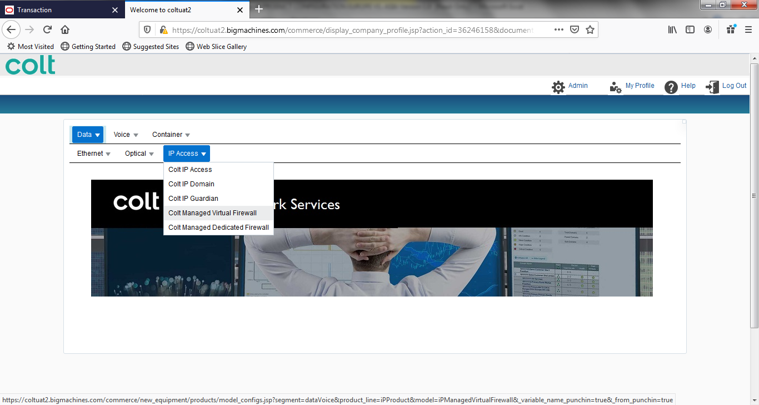
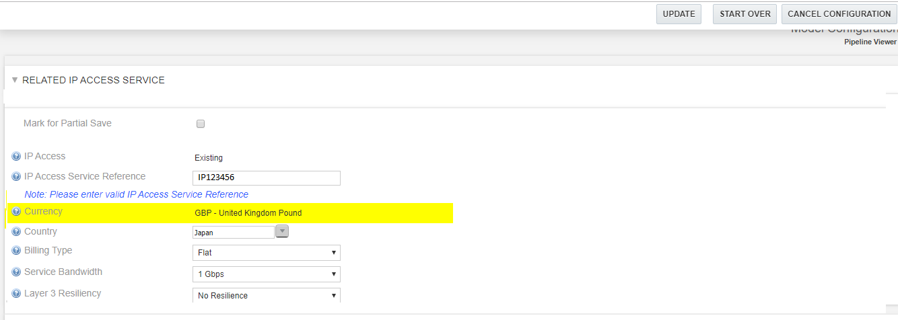
CPQ Asia : IP Access- Managed Virtual Firewall
Managed Virtual Firewall Service for IP Access will not be available for Asian countries (Japan, Singapore, Hong Kong, South Korea)
Error message to be shown ‘Managed Virtual Firewall is not supported in Japan, Singapore, Hong Kong and South Korea.
CPQ will throw an error when these countries are selected in the drop-down for Managed Virtual Firewall Service. The rule when user click ‘Save’ or ‘Update’
.
Managed Virtual Firewall is not supported in Japan, Singapore, Hong Kong and South Korea.

Slide 44
Productised Products – Wave Product (Asia Variation)
Generic
Wave Specific (Agreed)
Hong Kong Supplier Surcharge
Shall be visible if applicable.
Internal Cabling
Shall not be available if Access Type other than Colt Fiber.
Fast Track
Not available in Asia
Building Management Owner Charge
Shall be possible to be manually entered if applicable.
Relay Fiber
New Field required without any rule set as depending on value different workflows will be triggered in SPARK Asia. Interface logic needed to pass ULL Supplier first as only when specific Business rule met in SPARK Interface will allow to pass the value.
Interfaces (Service Type)
New Interfaces with associated Service Bandwidths & availability logic required.
Resilience
New Resilience Type Backbone Protection to be introduced.
Performance Reporting
New Global Feature Performance Reporting to be introduced.
Presentation Interface
New Presentation Interfaces required.
Dual Customer Power Source
Feature to be disabled in EU to align with Asia.
.

Slide 45
CPQ Asia : Wave– Long Line Surcharge
In Hong Kong , while doing the ULL check if the Building Type = ‘Retail Building (Long-Lining)’ then there is surcharge which needs to be added to the based price.
System should a message to user saying ‘A Surcharge has been added to the base price as the site is 10 KM from Central office’
The LL surcharge prices has to be implemented in the system , which is present in PAPIC. LL Surcharge for Hong Kong has to be uploaded in a CPQ data table.
The LL surcharge is not required to be shown on ‘Quote Line Item Grid’, ‘Quote Download Template’ , ‘Proposal’ and ‘Pricing Grid’
This is required across all product (except PS) when the country is Hong Kong
742-748 Cheung Sha Wan Road, Cheung Sha Wan, Hong Kong
Price Grid
45

Slide 46
CPQ Asia : CPQ Asia : Wave-BMO
‘BMO Charge Applicable’ will shown on the Site details page when the ‘Site Country = ‘Hong Kong’’.
‘BMO Charge Applicable’ should be a LOV with a default value as ‘Please Select’ . User can click in the drop down to select ‘Yes’ / ‘No’
When the Site country is other then ‘Hong Kong’ then this field will be hidden.
There will be a guidance message appearing on the screen for those user who are not aware BMO charges
Sales can refer the ULL connectivity check table to view the BMO related for guidance. These field are strictly for guidance purpose.
If user selects the BMO charges applicable then:
Sales user will be shown two fields to capture NRC and MRC
Sales are expected to manually enter the charges in HKG
In case Site Visit = N, then charges provided in the ULL connectivity table are firm charges
In case Site Visit = N & charge = NA then user can leave the BMO Charge Applicable as ‘NO’
In case Site Visit = N & charge = ‘No Extra Charge’ then user can leave the BMO Charge Applicable as ‘NO’
Sales user will offline get the firm prices from commercial operations in case BMO Site Visit = Y

Slide 47
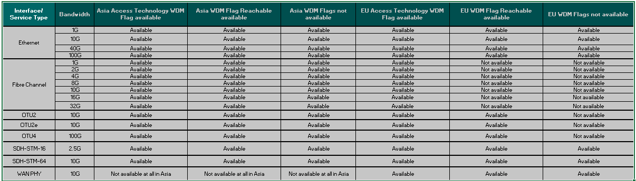
CPQ Asia : Wave-Interface and service bandwidth matrix
Updated service type-bandwidth matrix as below, rules to be updated in CPQ to show the correct bandwidth options based on the Interface and country
https://coltinternal.sharepoint.com/:x:/r/sites/isu/Quote%20to%20Bill%20Programme/Quote/DocCollaboration/Shared%20Documents/CPQ%20Asia/Requirements/Product%20Analysis/WAVE%20Asia%20Service%20Type_BW%20availability.xlsx?d=w50a5826f1d25471abe447d65d9fd1658&csf=1&e=N4cqiv
Bandwidth options “Not Available at all” will not be shown in the drop-down but the ones that are “Not Available” will need SE engagement

Slide 48
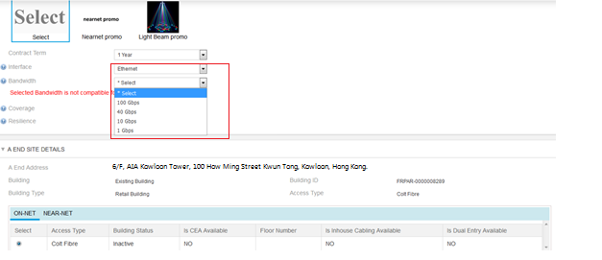
CPQ Asia : Wave-Interface and service bandwidth matrix
Drop-down options for bandwidth will be shown as per the interface chosen
Bandwidth option will be available as per the BIC(Bandwidth Interface Connector) matrix
Please note that ,no logic change on EU for the interface and bandwidth availability.

Slide 49
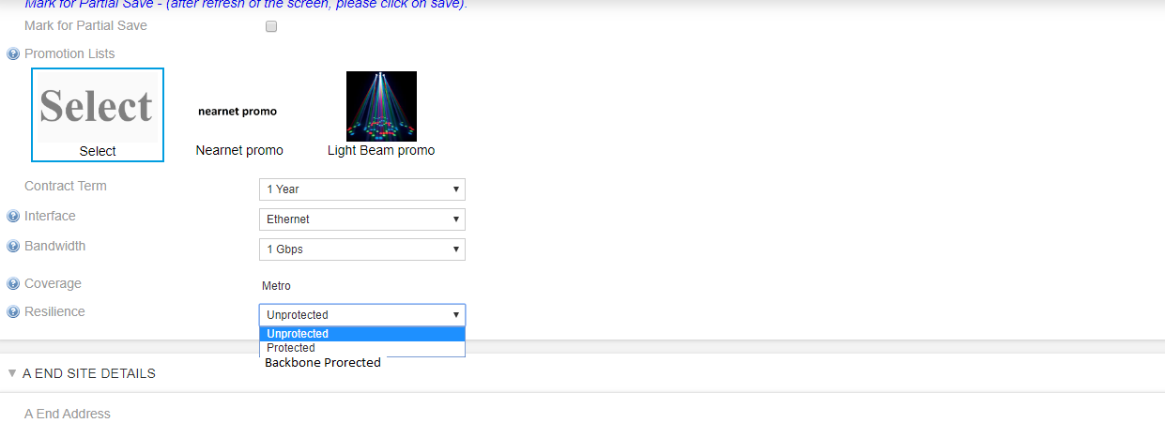
CPQ Asia : Wave-Resilience Backbone Protected
When
Both Site countries in Asia (Japan, Hong Kong, Singapore, South Korea)
Interface = Ethernet
Bandwidth <= 10 Gbps
One of the site building type is ‘Retail Building’
Then ‘Backbone Protected’ resilience option to be enabled in the drop-down for selection
For OLO scenarios ,Backbone protected & Protected resilience will not be available
No further configuration change due to this change
Manage Order: Mapping matrix should consider ‘Backbone Protected’ resiliency as well
Pricing table updates to be required
742-748 Cheung Sha Wan Road, Cheung Sha Wan, Hong Kong

Slide 50
CPQ Asia : Wave-Internal cabling
Internal Cabling is a globally orderable feature at site level when Access type is Colt Fibre. It will be not applicable for any other access type.
Charge for Internal cabling for Asian sites will always be zero when Site Country is = ‘Japan’, Singapore’,’HongKong’ , ‘South Korea’ .

Slide 51
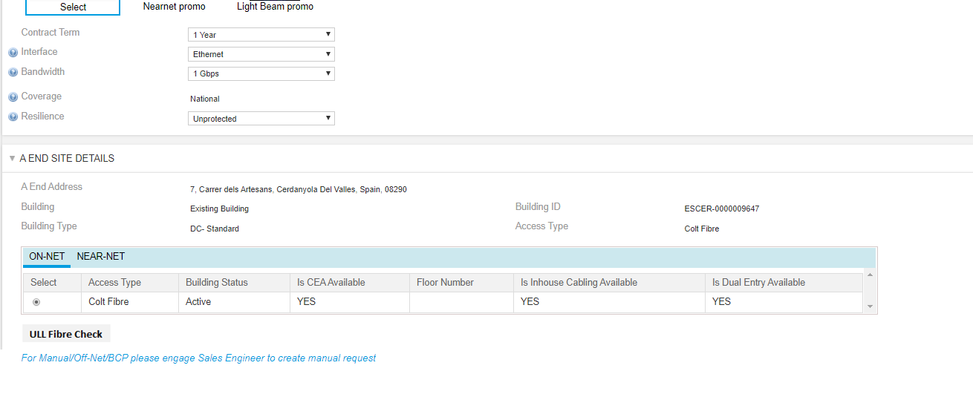
CPQ Asia : Wave-Internal cabling
On the Site Detail page, there will be new option called ‘ULL Fibre Check’ which will be present once user moves from Site address to site details page.
ULL Fibre check will provide results only for Japan, Singapore and Hong Kong. For Other countries it would return a error message.

Slide 52
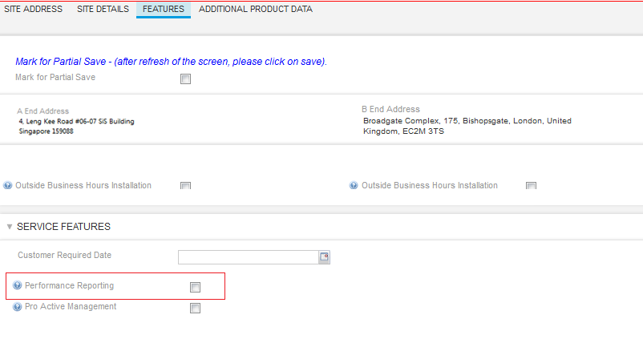
CPQ Asia : Wave-Performance Reporting
Performance reporting will be available as a global service level feature for Wave product
There are no business rules for selection of performance reporting.
The value will be passed to Siebel as is.

Slide 53
CPQ Asia : Wave-Fast Track
Fast Track is a service level feature
When one of the Site Country is = ‘Japan’, Singapore’,’HongKong’ , ‘South Korea’ then this feature has to be disabled

Slide 54
CPQ Asia : Wave- Dual Customer Power Source
Dual Customer Power Source to be removed from CPQ for selection in Ethernet Line journey for both EU and Asia
CPQ should send the ‘Dual Customer Power Source’ as ‘No’ to Siebel in Manage Order
As –is UI
Proposed UI – Dual Customer Power Source Removed
54

Slide 55
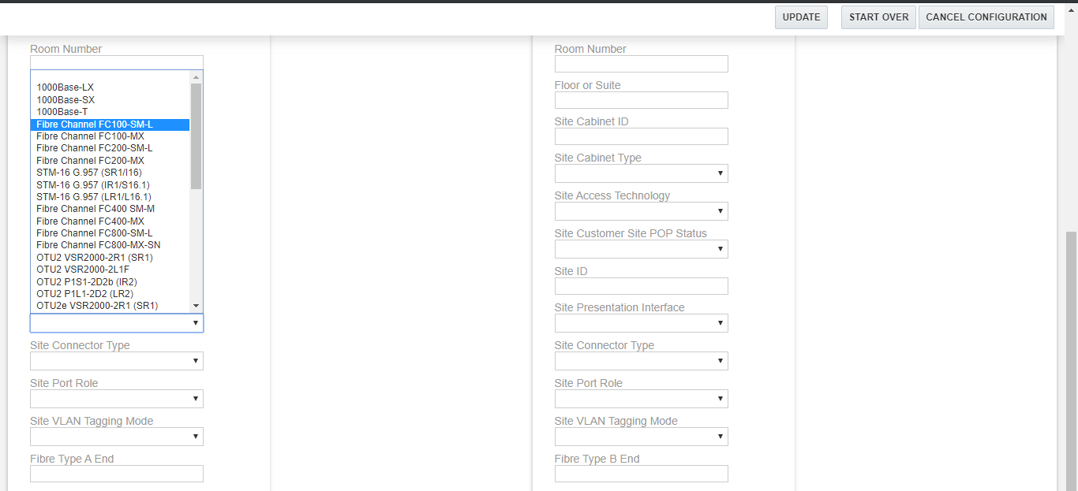
CPQ Asia : Wave- Presentation Interface
In additional product data tab-New presentation interfaces to be added in the drop-down for selection by SE
No business rule to be added.
CST team will validate the presentation interface selection
Sharepoint location of the list of presentation interface is below: https://coltinternal.sharepoint.com/:x:/r/sites/isu/Quote%20to%20Bill%20Programme/Quote/DocCollaboration/Shared%20Documents/CPQ%20Asia/Design/HLD/WAVE%20Asia%20Service%20Type_BW%20availability.xlsx?d=wca22a0f913d945e394837d6eb51d74d0&csf=1&e=0woH4O

Slide 56
CPQ Asia : Wave-Relay Fibre
CST will be allowed to optionally select Relay Fibre options (Yes, No, Blank) under additional product data during technical review journey
Fibre Relay field will only be enabled in CPQ when ULL Suppliers for Japan are NTTEAST(JP) or NTTWEST(JP). For all other scenario it should be hidden
Relay Fibre can be selected at site level.

Slide 57
Container – All Products
Open
Asia specific Product Offering
Proposal 1: Any Product currently not supported via Container will need to continue the Asia AS IS process and will not be supported by CPQ/ QTO Container Journey & Process.
Proposal 2: Single “Asia Legacy” Product Offering will be introduced to support Technical Changes for ‘Stop sell’ /’Legacy’ Products. Will need agreement from Order Entry team.
Asia Voice Products
Voice Product Names are aligned. Product alignment ongoing estimated date received Q2 next year.
Proposal: Product Team to drive this. Product Team to continue alignment, create & agree aligned EOF with Sales, SE, CST & OE representatives from EU & Asia.
If everything available and aligned can go through CPQ/ QTO Container Process no system limitation. If not will need to come later whenever this activity has been completed.

Slide 58
CPQ : Professional Service
Professional Service Name | Aligned with EU | Actions/Next Steps
Service Management | Yes | NA
Project Management | No | Internal discussion on-going to Align
Consultancy | No | Internal discussion on-going to Align

